Slide 1

CS-464 Final Presentation Sentiment Analysis
Group 23
21903488 Emrehan Hoşver
21901798 Gökberk Altıparmak
21802480 Tuğberk Dikmen
21901418 Efser Efe Kantik

Slide 2

Problem Definition
How can sentiment analysis of customer feedback enhance e-commerce operations and customer satisfaction?

Slide 3
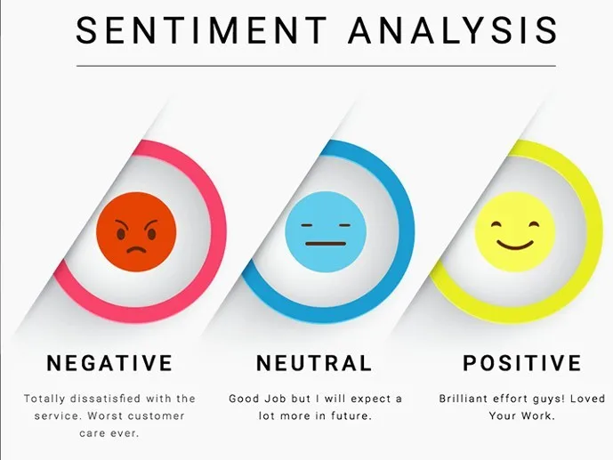
Labeling
Sentiment ranting out of 5
negative
rating < 3
neutral
rating = 3
positive
rating > 3
fig. 1: sentiment analysis

Slide 4
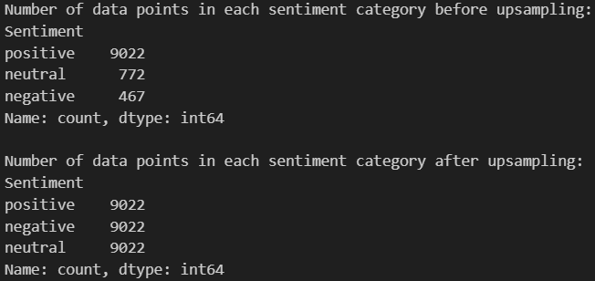
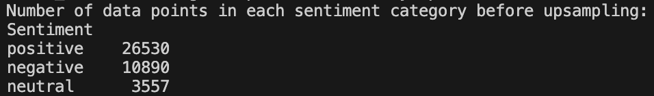
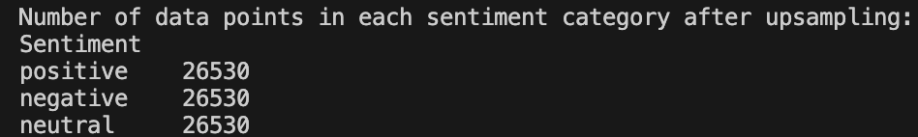
Dataset Preprocessing
Amazon Dataset
Unbalanced sentiment categories
Stop word removal (English)
Brazilian E Commerce Dataset
Unbalanced sentiment categories
Stop word removal (Portuguese)

Slide 5
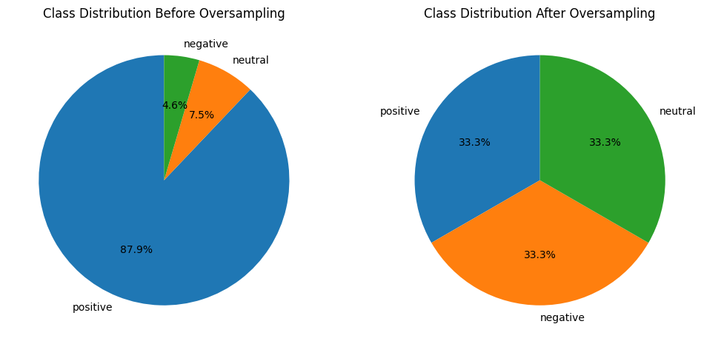
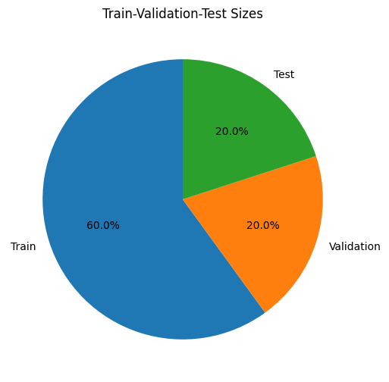
Amazon Dataset Visualization
fig. 2: before sampling
fig. 3: after sampling
fig. 4: dataset distribution

Slide 6
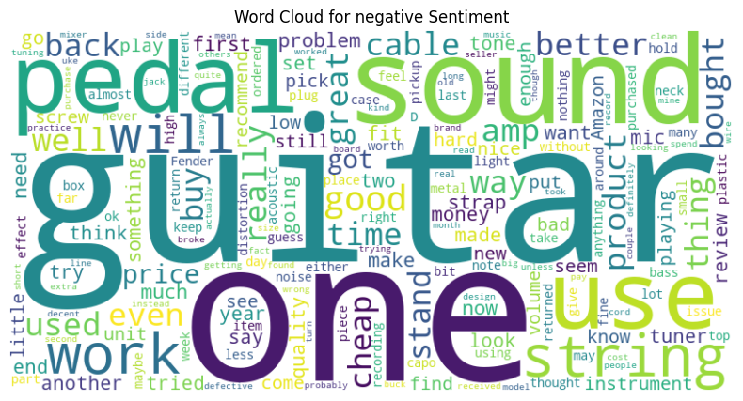
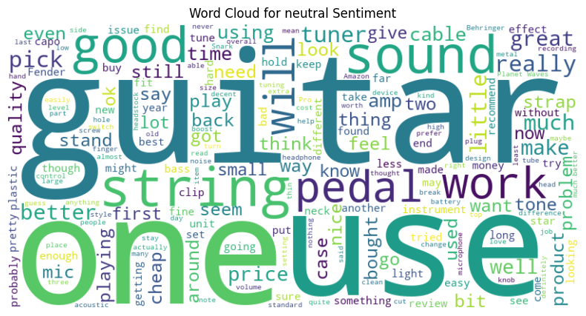
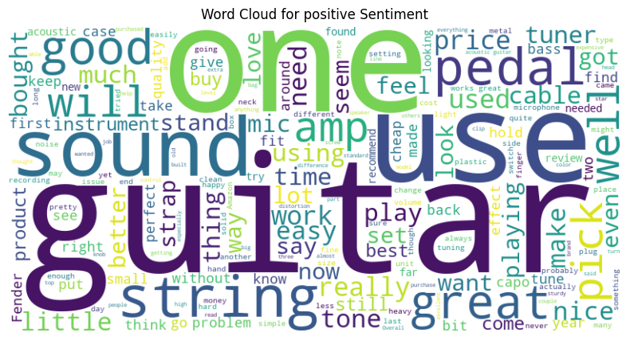

Word Cloud for Sentiment Classes of Amazon Dataset
fig. 5: word cloud

Slide 7
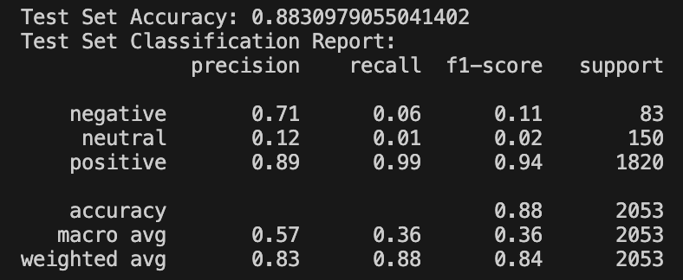
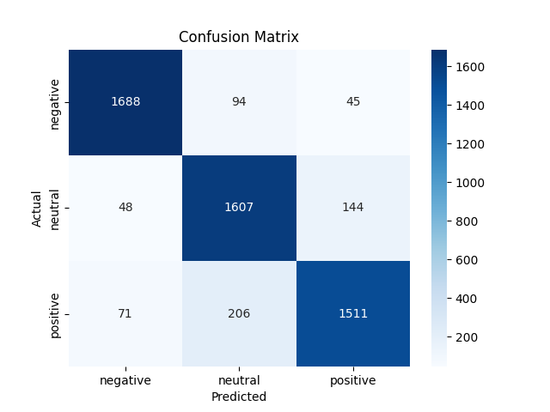
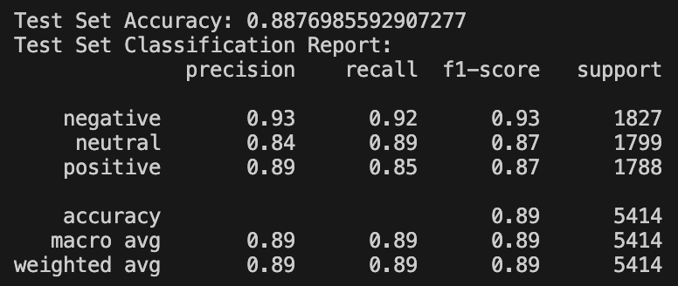
Multinomial Naive Bayes - Amazon Dataset
Before oversampling the positive and negative variables on dataset
After oversampling
After oversampling the positive and negative variables on dataset

Slide 8
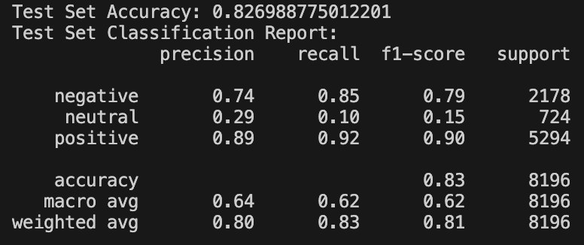
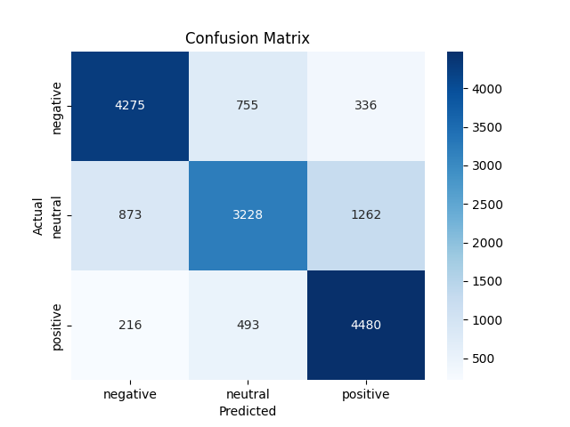
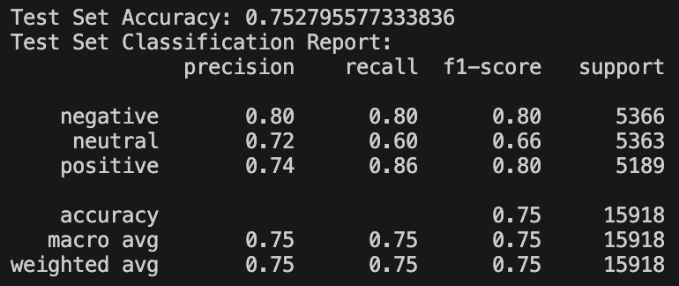
Multinomial Naive Bayes - Brazilian E Commerce Dataset
Before oversampling the positive and negative variables on dataset
After oversampling
After oversampling the positive and negative variables on dataset

Slide 9
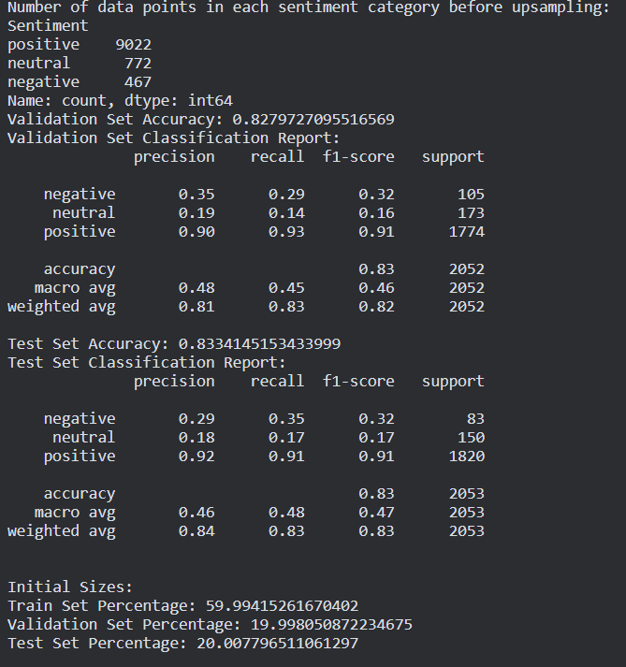
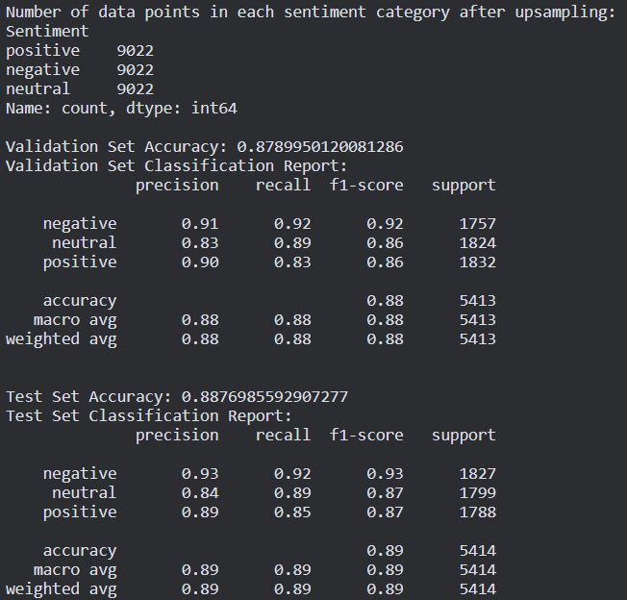
SVM - Amazon Dataset

Slide 10
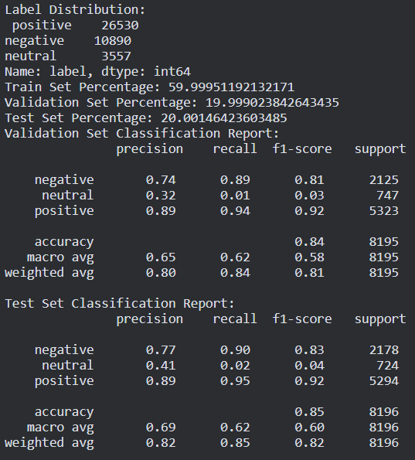
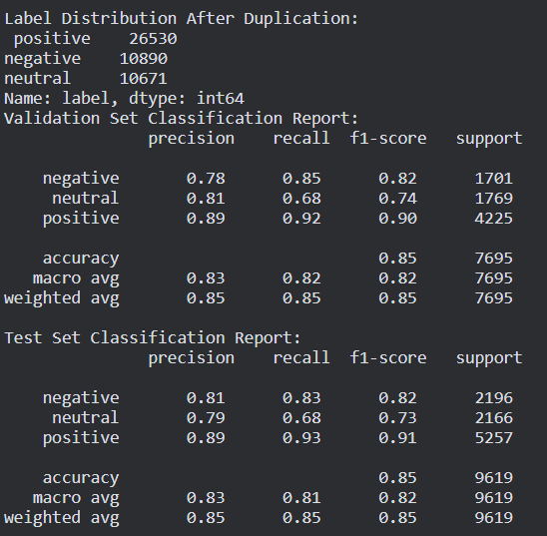
SVM - Brasil Dataset

Slide 11
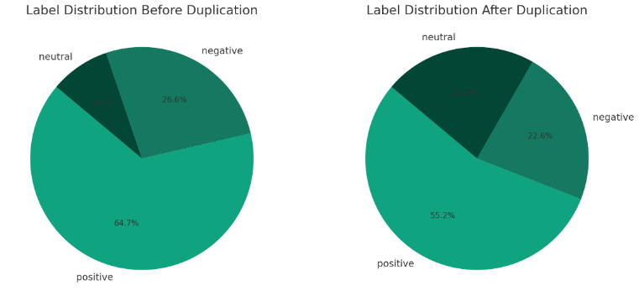
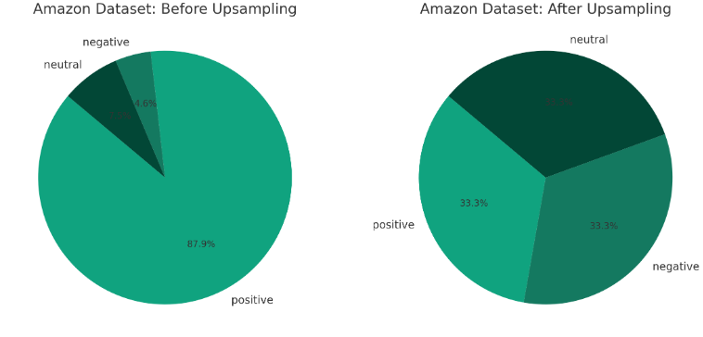
SVM Datasets
fig. 6: label distribution

Slide 12
RNN
Recurrent Neural Networks
Two Layers
LSTM (Long Term Short Term Memory)
GRU (Gated Recurrent Units)
Adam Optimizer

Slide 13
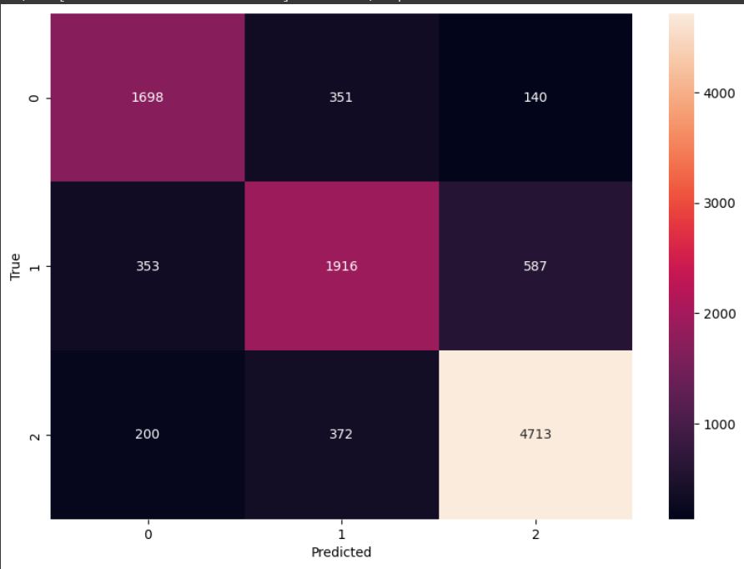
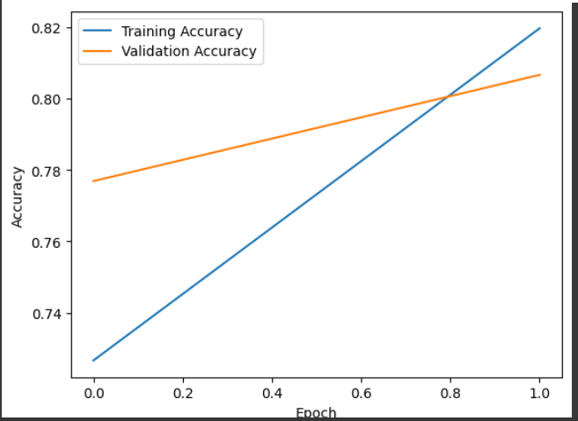
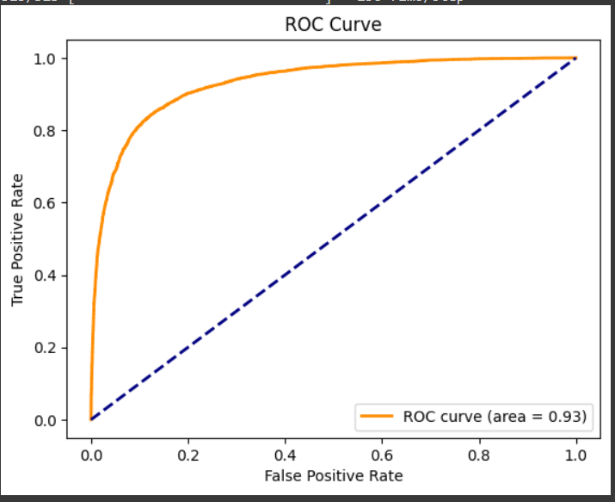
RNN Results
Batch = 32 Epoch = 2 Learning Rate = 1e-3 Accuracy = 0.8

Slide 14
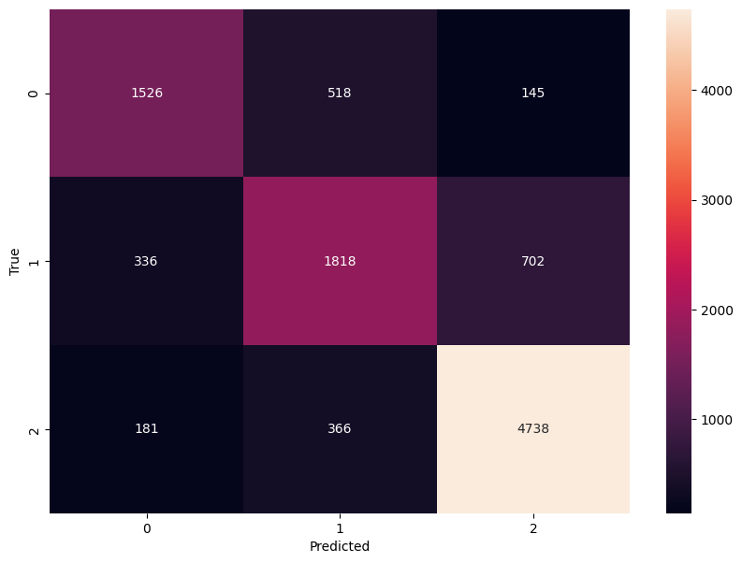
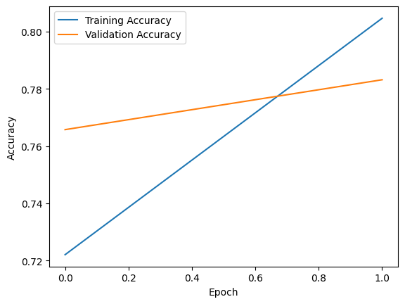
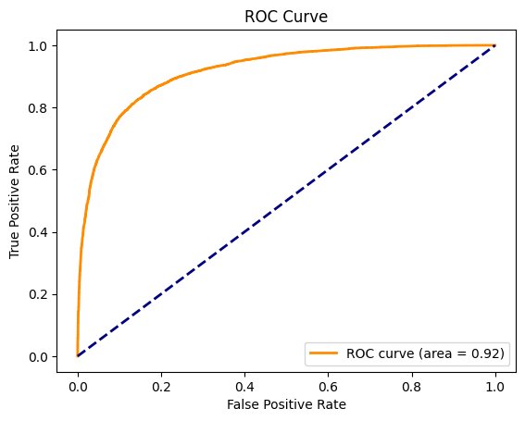
RNN Results
Batch = 64 Epoch = 2 Learning Rate = 1e-2 Accuracy = 0.78

Slide 15
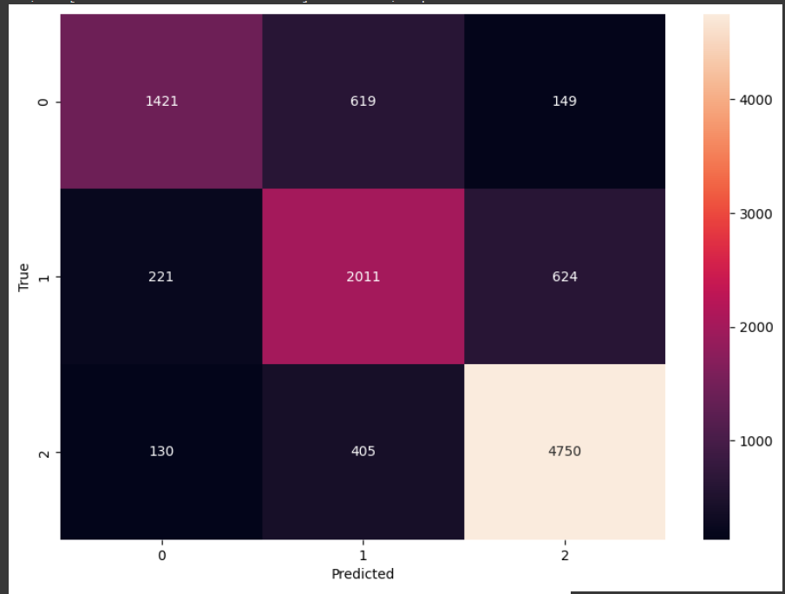
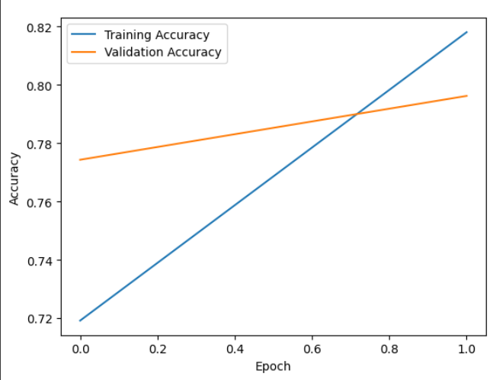
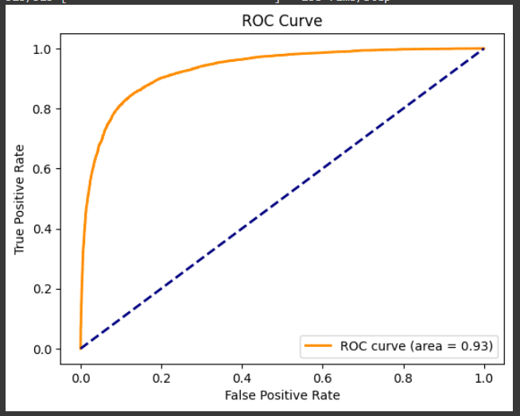
RNN Results
Batch = 64 Epoch = 2 Learning Rate = 1e-3 Accuracy 0.79

Slide 16
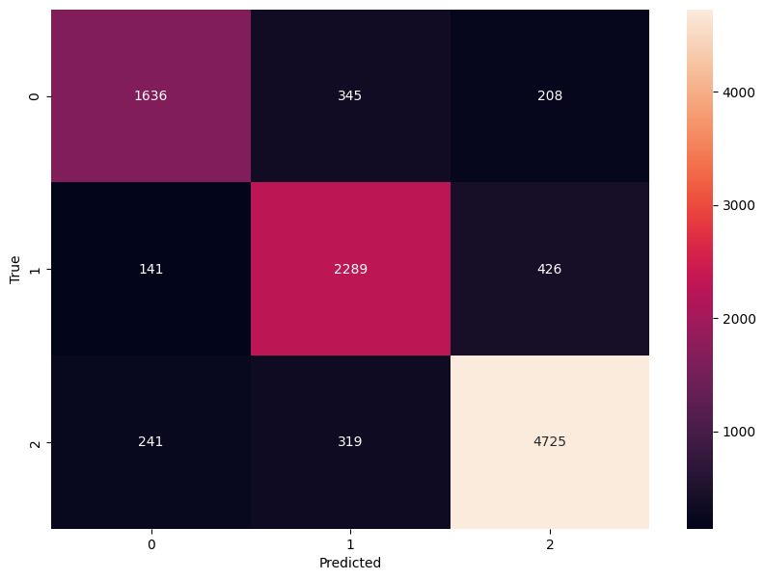
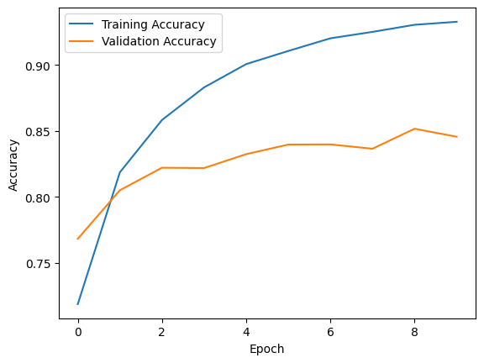
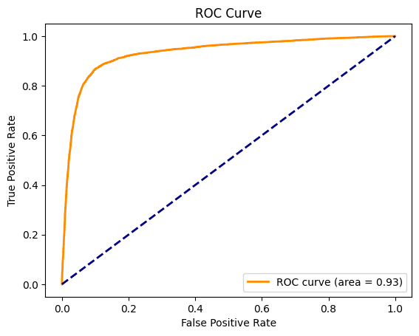
RNN Results
Batch = 64 Epoch = 10 Learning Rate = 1e-3 Accuracy 0.84

Slide 17
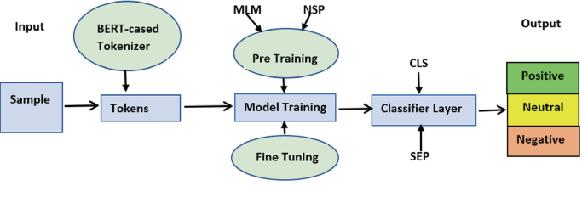
BERT
(Bidirectional Encoder Representations from Transformers)
Powerful natural language processing (NLP) model
Contextual understanding
BERT tokenizer ('bert-base-uncased')
One-hot Encoding
The TFBertForSequenceClassification model is initialized
Pre-trained weights from the 'bert-base-uncased' version.
AdamW optimizer
fig. 7: BERT

Slide 18
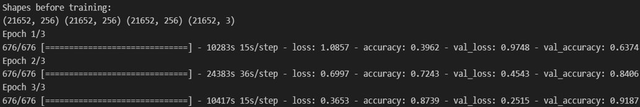
BERT
Hyperparameters:
Learning Rate: 2e-5
# of Epochs: 3
Effective Batch Size: 32
Gradient Accumulation Steps: 2
Optimizer: AdamW
Validation Performance Accuracies:
First Epoch: 63.7%
Second Epoch: 84.1%
Third Epoch: 91.9%

Slide 19
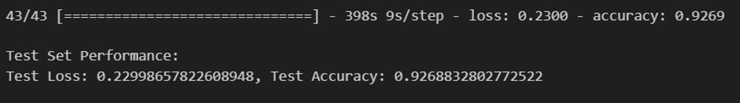
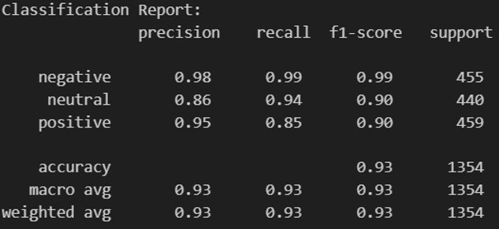
BERT
Performance Results:

Slide 20
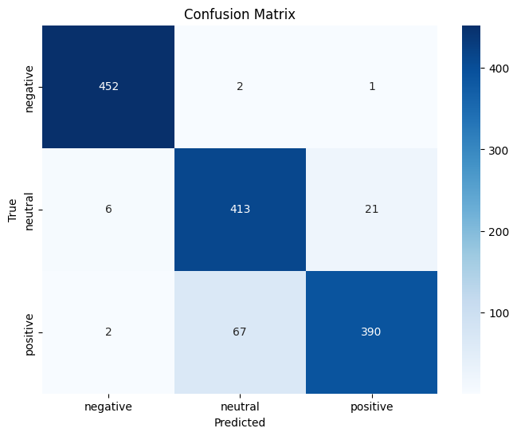
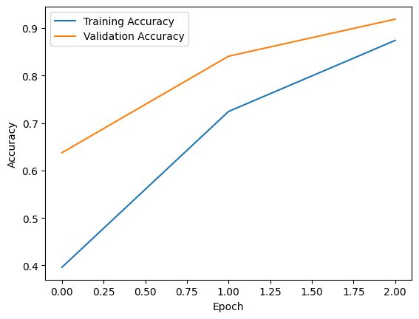
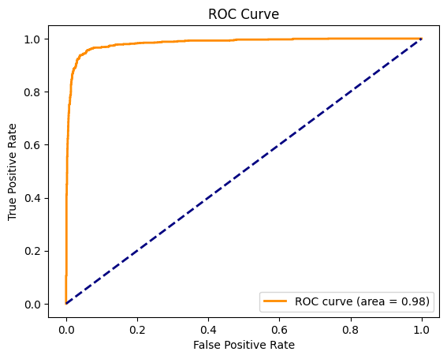
BERT

Slide 21

Comparison of Each Model for Amazon Dataset
​ | Multinomial Naïve Bayes​ | SVM | RNN​ | BERT​
Test Accuracy​ | ​0.88 | ​0.87 | ​0.87 | 0.93​
​ | Multinomial Naïve Bayes​ |  |  | SVM |  |  | RNN​ |  |  | BERT​
 | ​ |  |  | ​ |  |  | ​ |  |  | ​
Precision​ | 0.89 | 0.84 | 0.93 | 0.89 | 0.84 | 0.93 | 0.95 | 0.75 | 0.72 | 0.95 | 0.85 | 0.98
Recall​ | 0.85 | 0.89 | 0.92 | 0.85 | 0.89 | 0.92 | 0.88 | 0.88 | 0.80 | 0.85 | 0.94 | 0.99

Slide 22
REFERENCES
[1] Olist, “Brazilian E-Commerce Public Dataset by Olist, ” Kaggle. [Online]. Available: https://www.kaggle.com/datasets/olistbr/brazilian-ecommerce [Accessed: Oct 19, 2023].
[2]”1.9.NaiveBayes,”scikit-learn.org.[Online]. Available:https://scikit-learn.org/stable/modules/naive_bayes.html [Accessed: Nov 22, 2023].
[3]”1.4. Support Vector Machines,” scikit-learn.org. [Online]. Available: https://scikit-learn.org/stable/modules/svm.html# [Accessed: Nov 23, 2023].
[4]”sklearn.svm.SVC,”scikit-learn.org.[Online]. Available:https://scikit-learn.org/stable/modules/generated/sklearn.svm.SVC.html#sklearn.svm.SVC [Accessed: Nov 23, 2023]
[5]E. Chand, “Amazon Musical Instruments Reviews ” Kaggle. [Online]. Available:https://www.kaggle.com/datasets/eswarchandt/amazon-music-reviews [Accessed: Oct 25, 2023].

